Slide 1
“ELSIE and the Lost Battery Charger”
Digital Storytelling with Twine

Slide 2
Choose Your Own Adventure” books

Slide 3
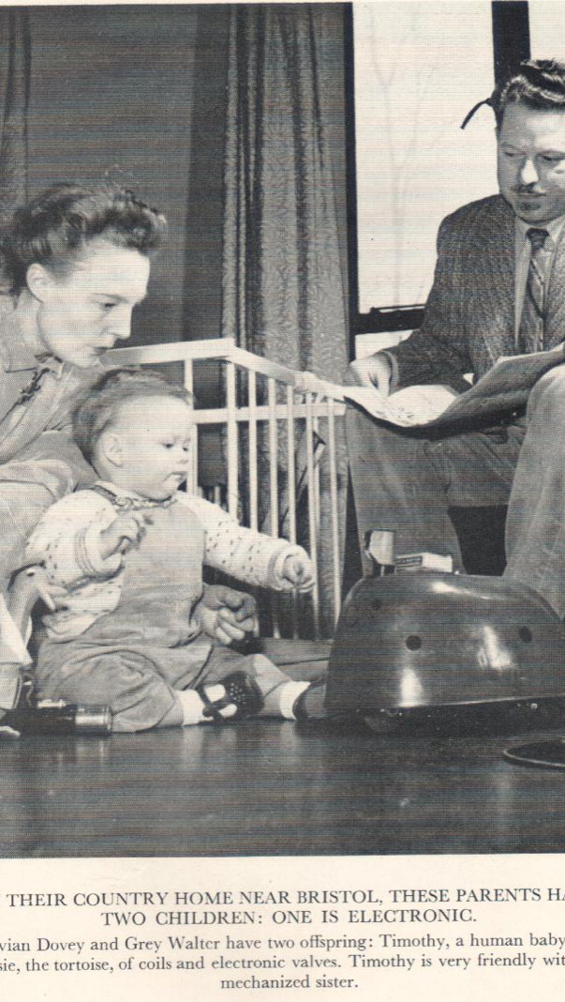
E.L.S.I.E
ELSIE is the world’s first autonomous robot, built in Bristol in 1948 by Grey Walter.
Electro-mechanical robot,
Light
Sensitive with
Internal and
External stability.
https://youtu.be/lLULRlmXkKo

Slide 4
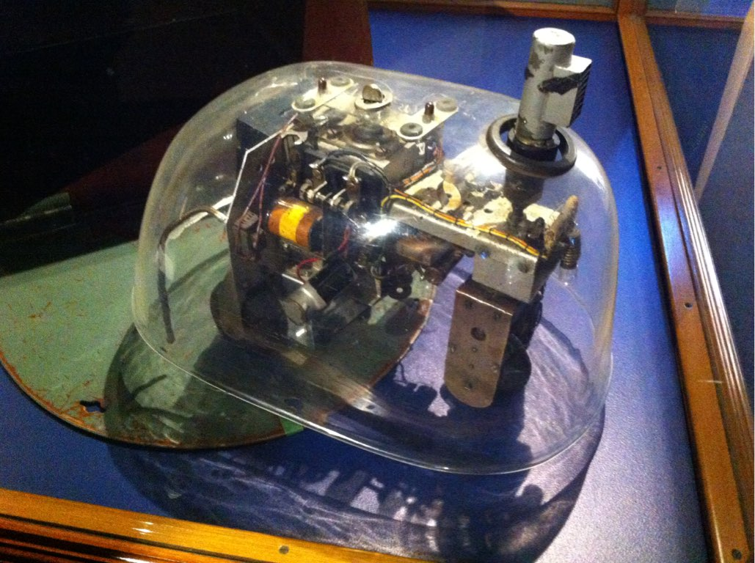
Grey Walter’s, Tortoise N^{o6}
Light Sensitive
Internal Stability
(battery level)
External Stability
(bumper)
Electromechanical
robot
N^{o6} at the Science Museum, London

Slide 5
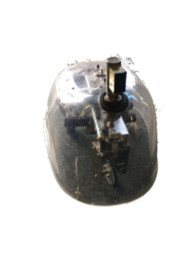
Can ELSIE find her battery charger in time?
Battery
charger
✘
✘
Hallway
Kitchen
Bedroom
Living room
Dining room
Bathroom

Slide 6

Twine : Digital Storytelling
Twine is for digital interactive storytelling (telling stories with computers).
Runs in your browser (no need to install)
But not Microsoft Edge (search for Chrome or Microsoft Explorer)
http://twinery.org
Try it

Slide 7
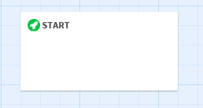
Start the story
Create a new story, +Story
Name it ‘ELSIE’, +Add
Add a ‘Passage’, +Passage (or you can work on the start passage already present)
Mouseover the passage to reveal the pop-up menu
Click on the pencil to edit, then rename as ‘START’ (click outside the box to exit)

Slide 8
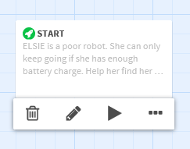
Move into the Kitchen
Mouseover the passage again and select the pencil to edit.
Select the text “Double-click this passage to edit it”
Add some text that describes the start of your story
(Close the window to exit)

Slide 9
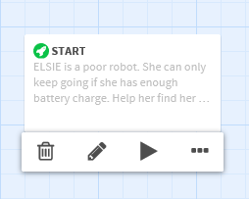
Play Your New Story
You’ve now started the story. The rocket icon in the top left-hand corner represents the start passage.
Press Play.
Close the browser tab to exit.

Slide 10
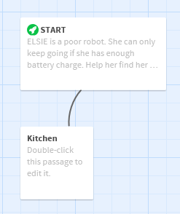
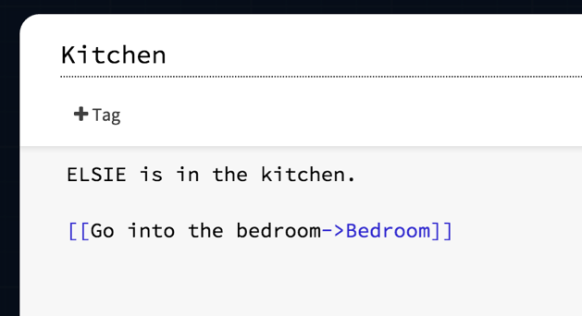
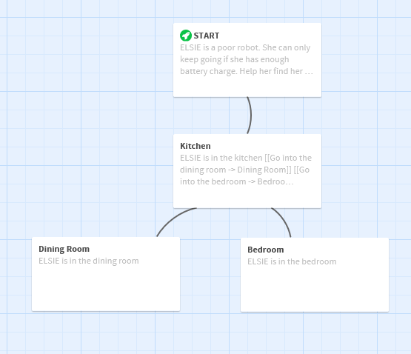
Hyper-linking
From the start, ELSIE can get to the Kitchen, Bedroom or the Dining Room.
Edit the passage (pencil) input: [[Go into the kitchen->Kitchen]]
This creates a hyper-link to a new ‘kitchen’ passage.
This is a hyper-text.
From the kitchen, add a bedroom and a dining room the same way (names may contain spaces).
Edit the text in the new passages.

Slide 11
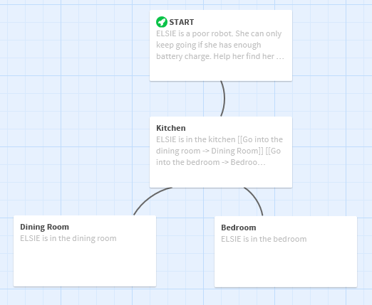

Play Your Story
Press Play Follow the links to move about
Click on the ‘undo arrow’ to go back.

Slide 12
ELSIE’s World
Add more links to get from:
the bedroom back to the kitchen.
the dining room back to the kitchen.
the dining room to a bathroom / and back again.
the dining room to the living room / and back again.
the living room to the hallway / and back again.
In the hallway, add new text (not a link), “Can ELSIE see the battery charger?”

Slide 13
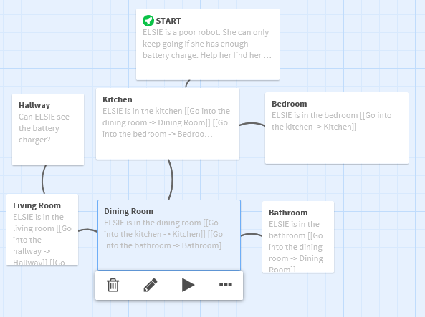
Debugging
You can see how any passage will look without going through the whole story by pressing ‘play’ from the passage.
Mouseover a passage, and select the ‘play’.
If you make a mistake, you can delete a passage with the ‘dustbin’.

Slide 14
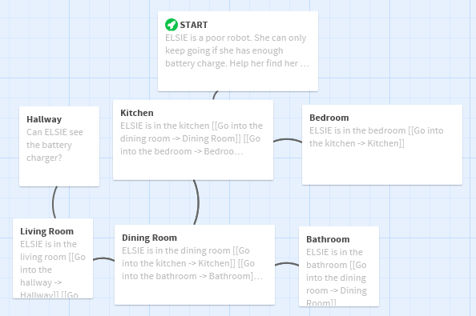
Play Your Story
Now we can move around the story.
(Notice I’ve rearranged my screen)
Press Play and find the charger.

Slide 15

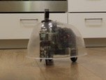
Photo-story
We can improve the story by adding photos.
In a new browser window open: http://go.uwe.ac.uk/elsie
Scroll down until you find a photo of ELSIE in the Kitchen.
Input a new line <img src=“”>
Copy the image address (right-click on image), or the address underneath, & paste between the quotes.

Slide 16
Play Your Story
Press Play
Now look for similar photos to add to the other rooms.
Don’t use the photos of ELSIE getting into trouble yet - that’s coming up.

Slide 17

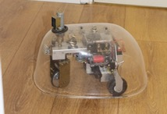
Game Over
In Hallway - Add [[brackets]] around “Can ELSIE see the battery charger” and link to ‘Battery Charger’.
Edit this new passage, and add an image of ELSIE recharging her batteries.

Slide 18

Emphasis
So we can create passages to describe things that ELSIE encounters, like the Battery Charger.
Words can be **emphasised**

Slide 19

Trouble Along the Way
Each room contains things that may be trouble.
In the bathroom, the mirror might cause trouble.
Link to the mirror (with suitable wording).

Slide 20

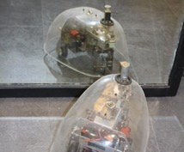
The Mirror Dance
In the new ‘Mirror’ passage, add a photo and a way back to the bathroom.
Try adding some kind of trouble to different rooms.

Slide 21

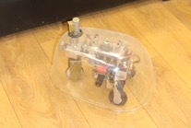
Help Along the Way
There may be other robots that can help ELSIE.
In the living-room, Roomba may help out.
Add a link to Roomba (with suitable wording).

Slide 22

Roomba to the Rescue
In the new ‘Roomba’ passage, add a photo and a way back to the living room.
Try adding some kind of trouble to different rooms.

Slide 23
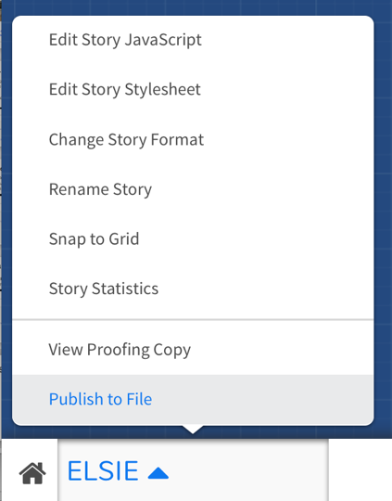
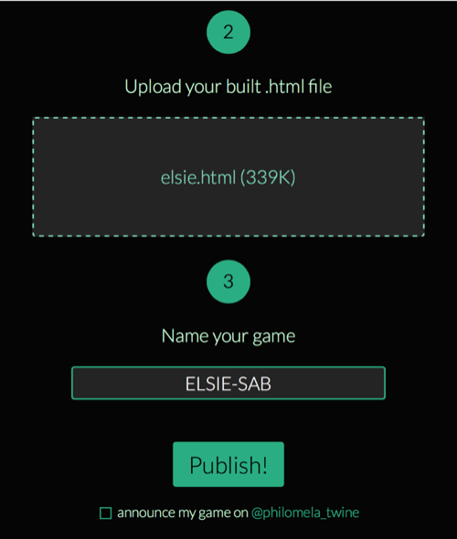
Save and Publish (?) Your Story
On the bottom let where t says ELSIE, select the up arrow and then ‘Publish to File’.
Save on the pen drive as e.g. ‘elsie.html’
If you want to publish your story: (only possible If you have a Twitter account)
Go to http://philome.la
Login with Twitter
Drag your file onto the upload area.
Input a name e.g ELSIE-YOURINITIALS
Uncheck announcement checkbox?
Click Publish > PLAY
Address is: http://philome.la/TWITTERNAME/STORY/play

Slide 24
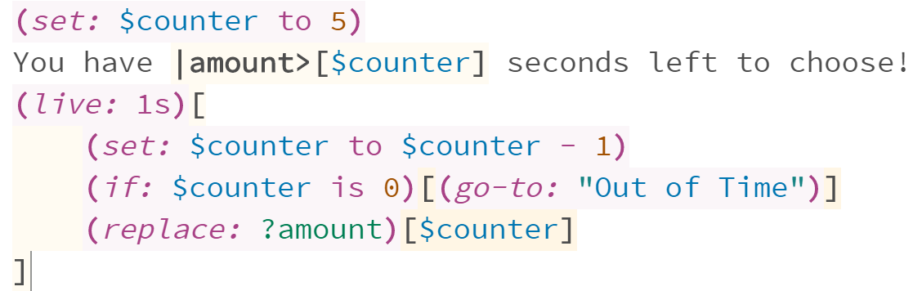
Extension
Use this command to add a timer and set the prompt and length of time to as many seconds as you would like:
You can work on any extension you would like, however the one option is to create a timer gives you a certain amount of time to explore each room upon entry
You can add this to as many passages as you want, making sure they all link to the same “Out of Time” passage.

Slide 25
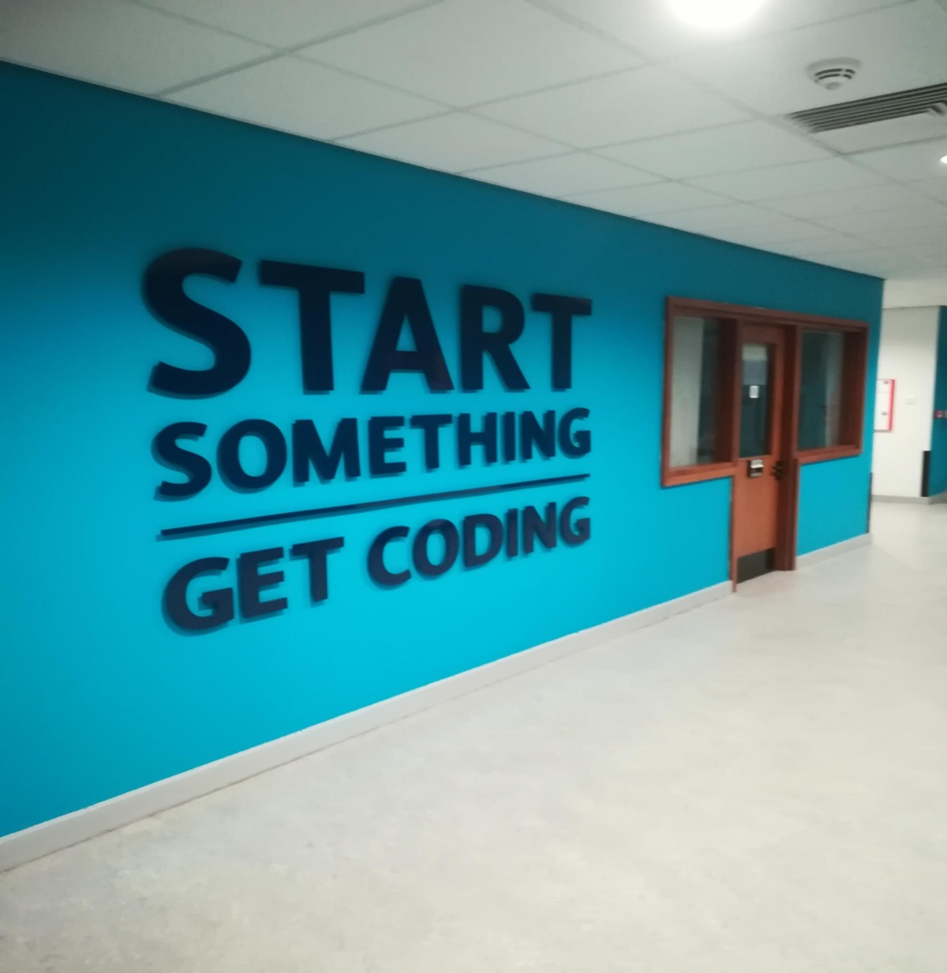
Thank You!
Thank You

